Slide 1

DOMAIN-SPECIFIC PDF SUMMARIZATION & KEYWORD EXTRACTION PIPELINE
By Kishan Tripathi

Slide 2
OBJETCTIVE
Design and implement a dynamic pipeline that processes multiple PDF documents from a desktop folder, generates domain-specific summaries and keywords, and stores them in a MongoDB database. The system must efficiently handle documents of varying lengths, from short to long, and update the database with summary and keyword data after each document is processed.

Slide 3
PDF PARSING
Used PyPDF2 to extract text from the pdfs
tried adobe api for structured parsing of the document but there wasn’t much improvement in the summary results and it wasn’t economical at scale so discareded.

Slide 4
SUMMARIZATION
for small pdfs the entire text is passed to llm at once for summary generation.
for medium and large pdfs used this same approach:
dividing the text into chunks of paragraphs with 10% overlap.
used these chunks to extract key sentences using tf-idf vectorizer.
generated the summary for those key sentences.
concatenated these individual summaries.
used these concatenated summaries to generate a final comprehensive summary.

Slide 5
SUMMARIZATION

Slide 6
KEYWORD EXTRACTION
used tf-idf vectorizer to find keywords from the entire document text.
took the summary and the keywords obtained from the vectorizer and gave it to llm to generate a final set of more refined contextual keywords.
tried doing this task using bert and some other methods but the output with the llm was much better than any of these.

Slide 7
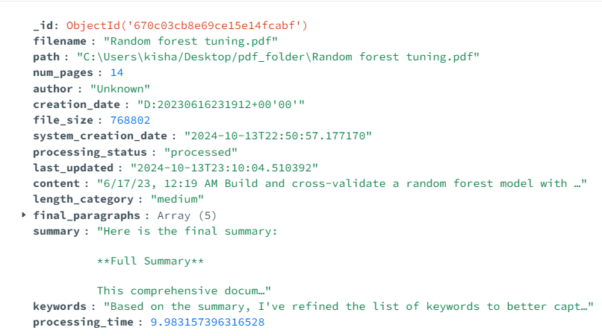
MONGODB UPDATES
both the summary and keywords are stored in the mongodb in a proper format along with some other important informations.

Slide 8
CONCURRENCY
ProcessPoolExecutor is used for parallel processing of the documents.
it can process a good number of documents effeciently.
for performace metrics various quantities are calculated like "processing_time" ,"avg_cpu_usage", "avg_memory_usage","avg_document_time" and per document processsing time.

Slide 9
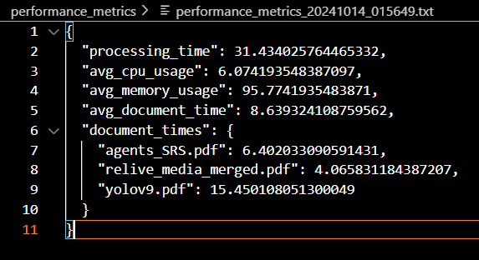
PERFORMANCE METRICS

Slide 10
IMPROVEMENTS
a better pdf parsing mechanism is need , structured is better what the adobe api is doing could be implemented.
summaries and keywords needs to be tested with the evaluation benchmarks so as to judge the quality, it looks fine but a good eval metric is needed.
memory utlization is very high it should be lowered with using effective parsing techniques.
an embedding method based on hierarchical clustering may give better results for the summaries.

Slide 11
THANK YOU
feedbacks are highly appreciated !!
kishantripathi888@gmaill.com

